Slide 1

Ever wondered ..
IF
YOUR
BRAND
SHINES

Slide 2
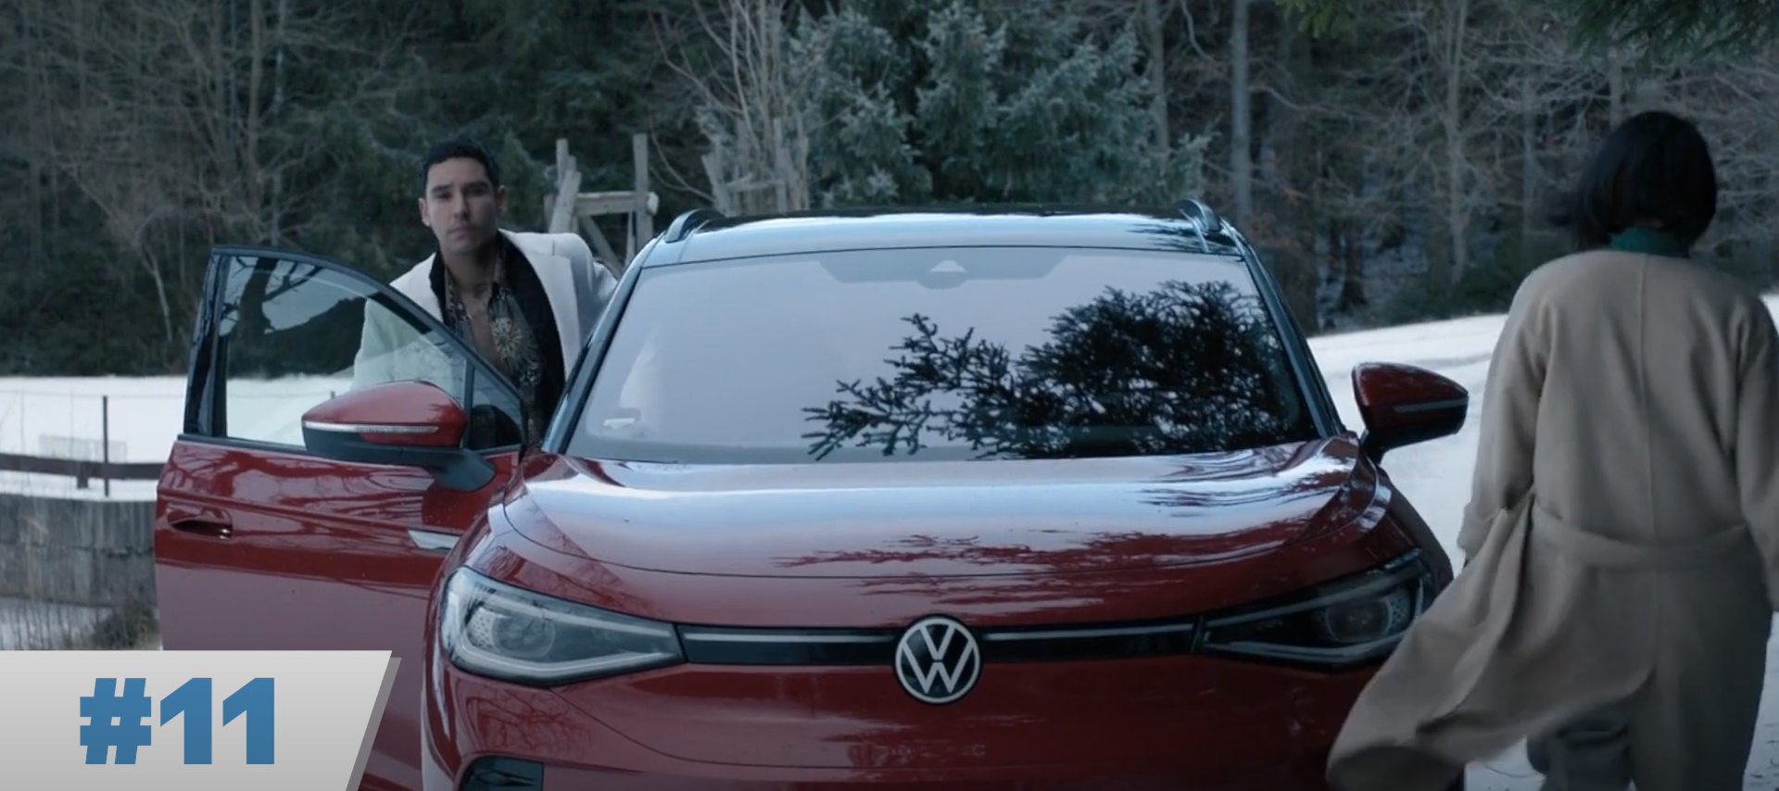
Extraction (Part II)

Slide 3
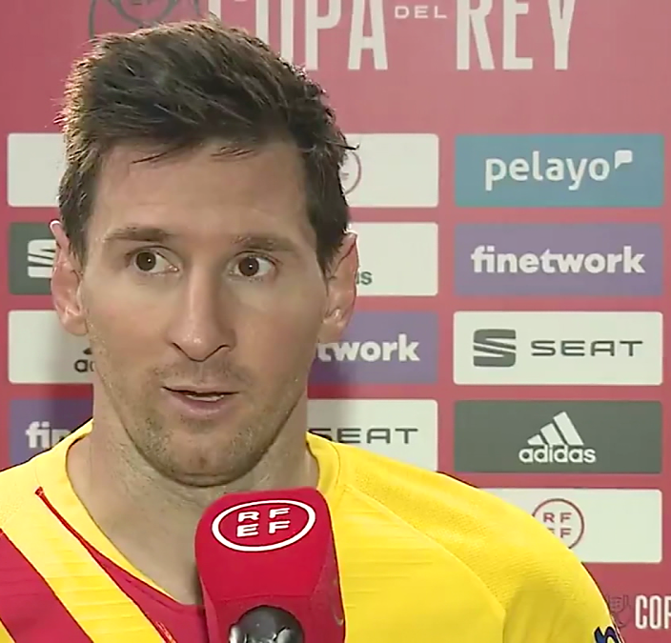
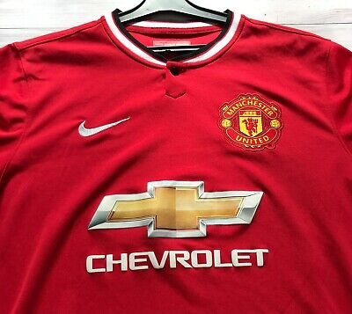
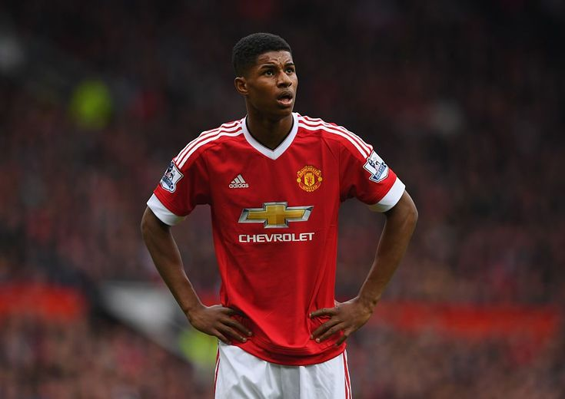
Extraction (Part II)

Slide 4

Brands
Are
EVERY- WHERE

Slide 5


Are They Getting
MILLIONS!
NOTICED?

Slide 7
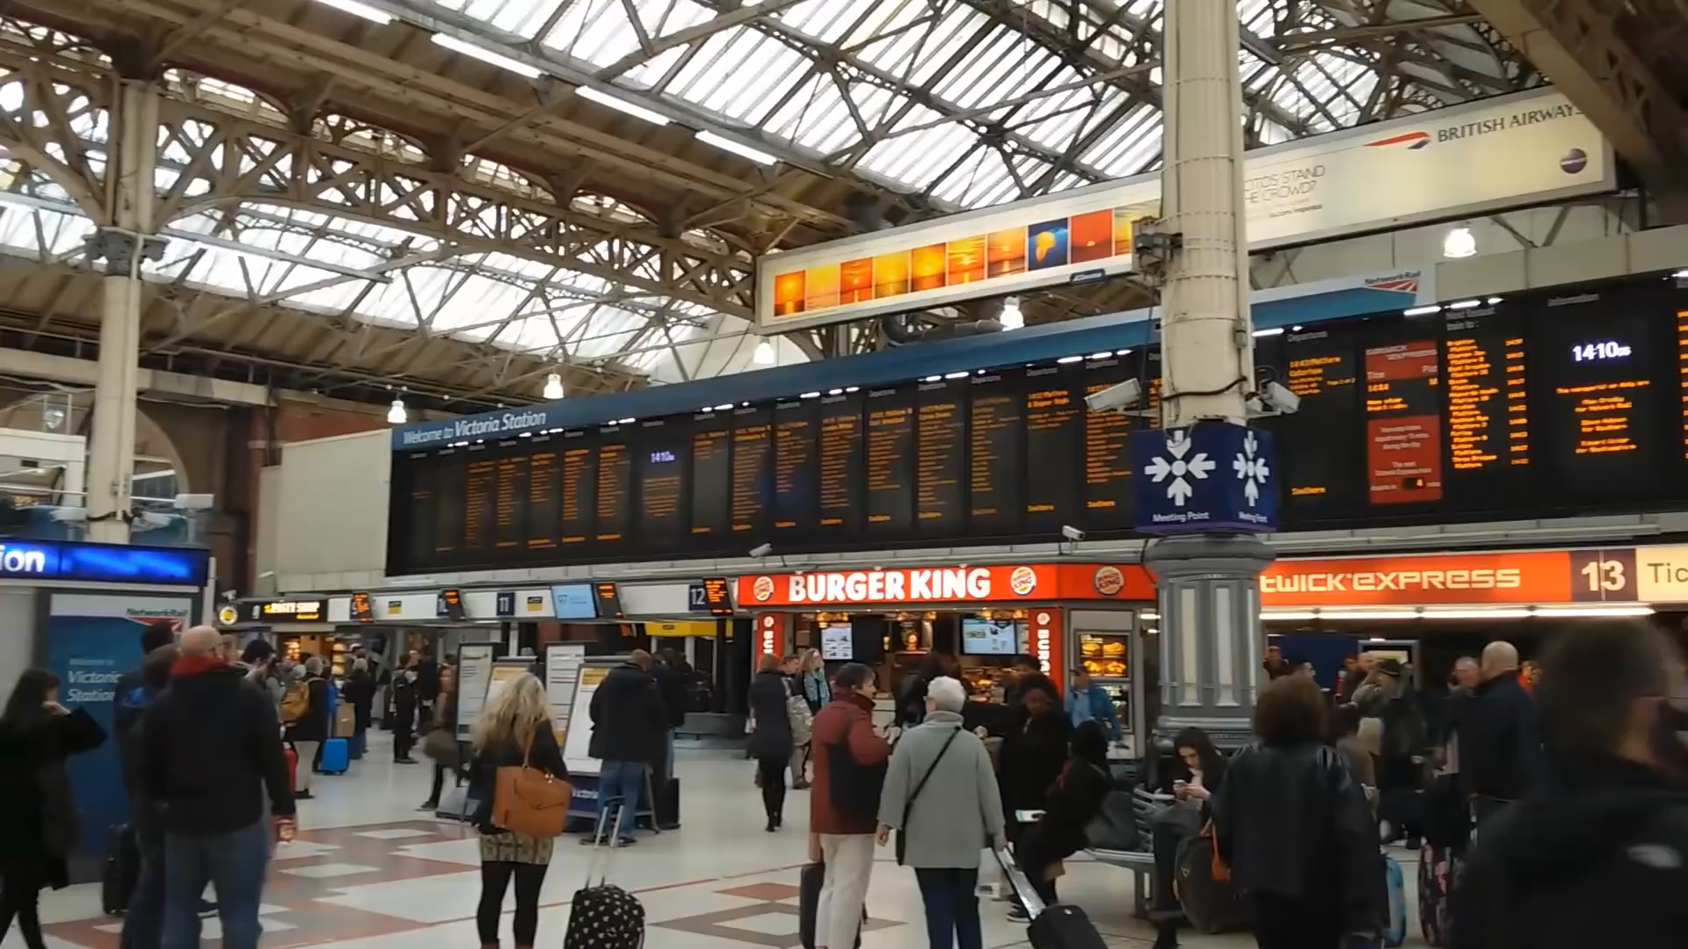

Slide 8
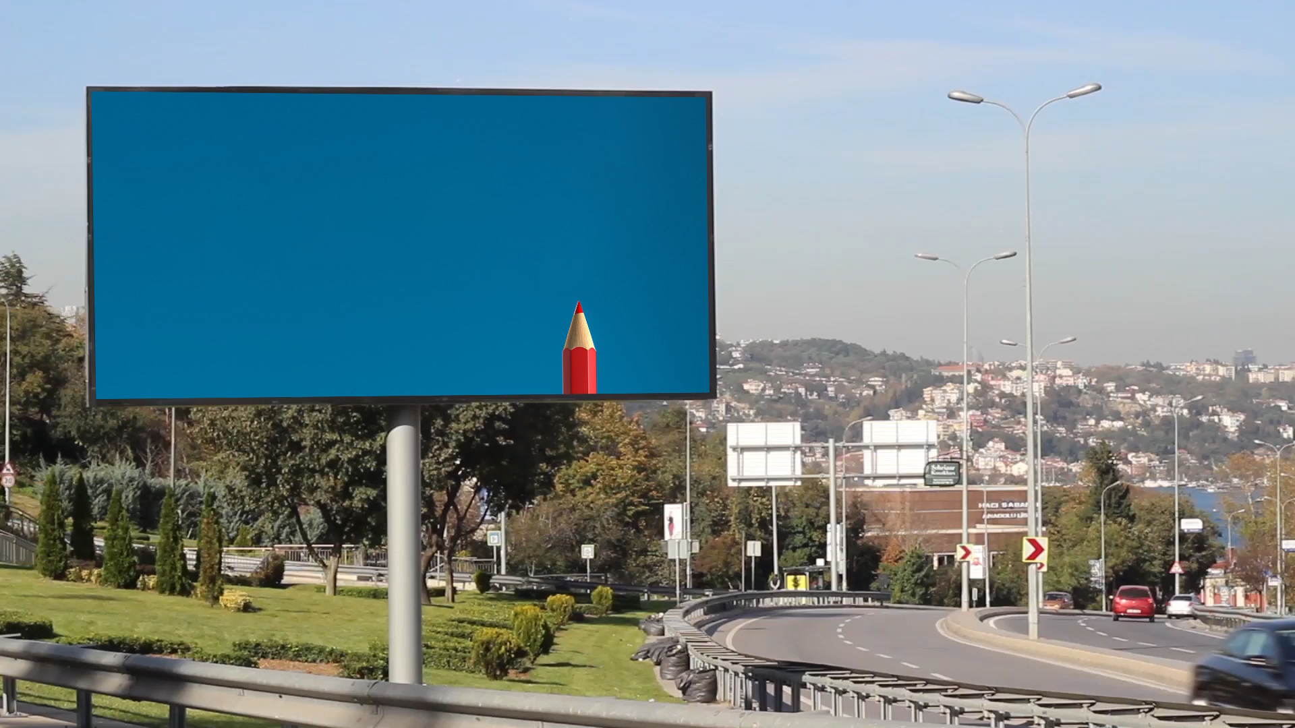

Slide 9
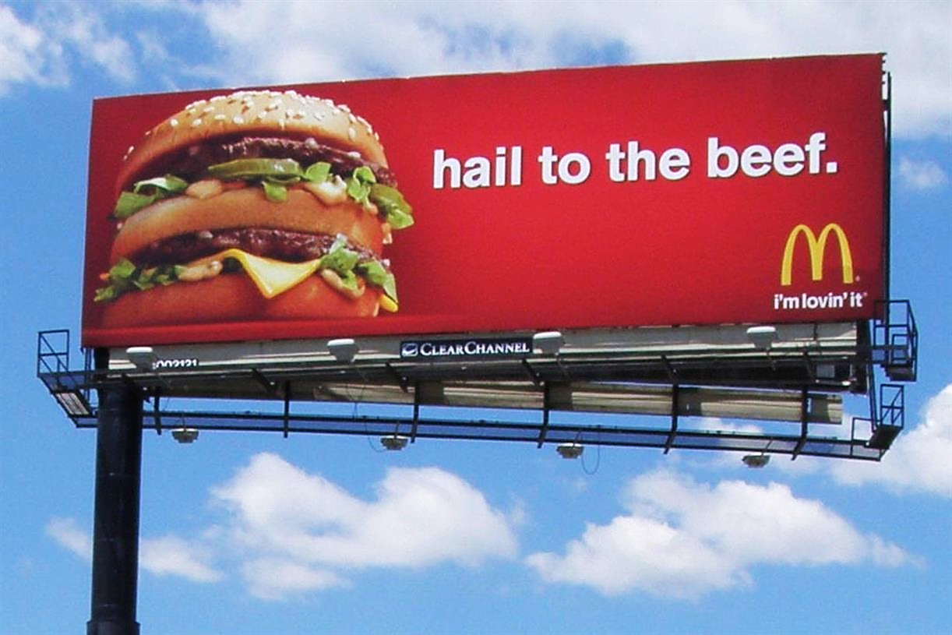
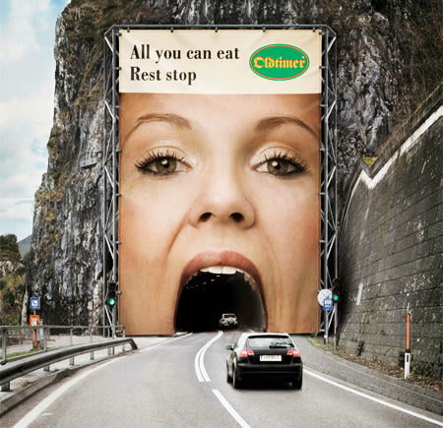
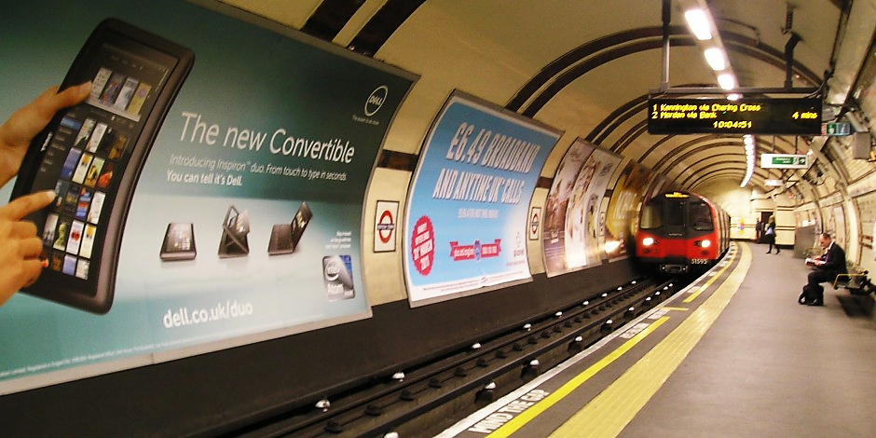

Slide 10

B
Brand Miner

Slide 12


Slide 13

B

Slide 14

B
B

